Slide 1
Web
Final Proposal
Yida Li

Slide 2
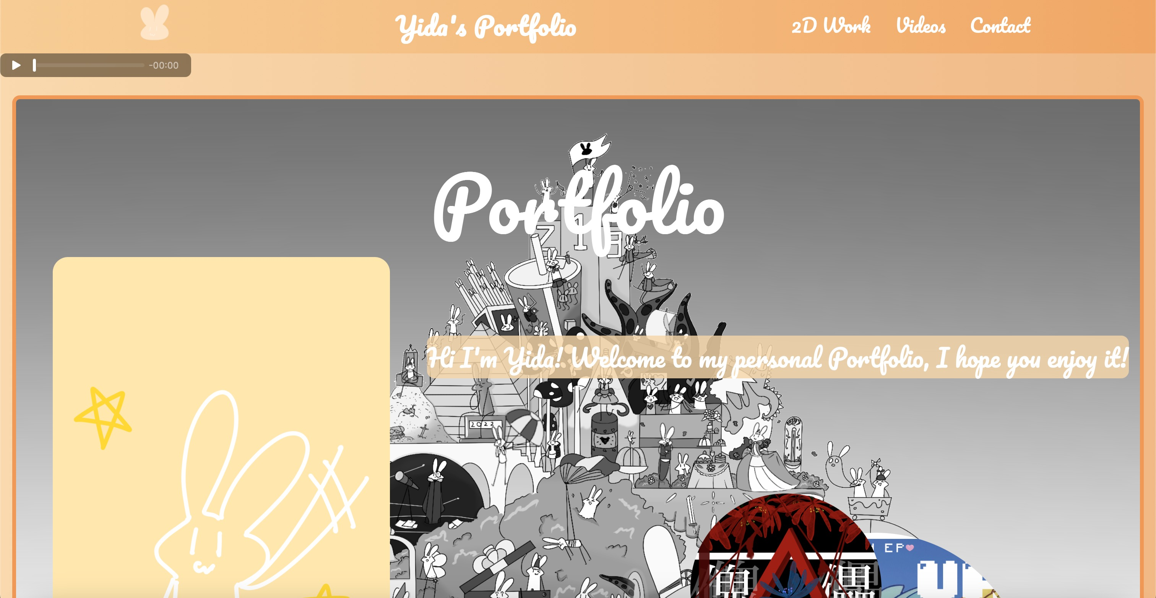
continuing with Midterm

Slide 3

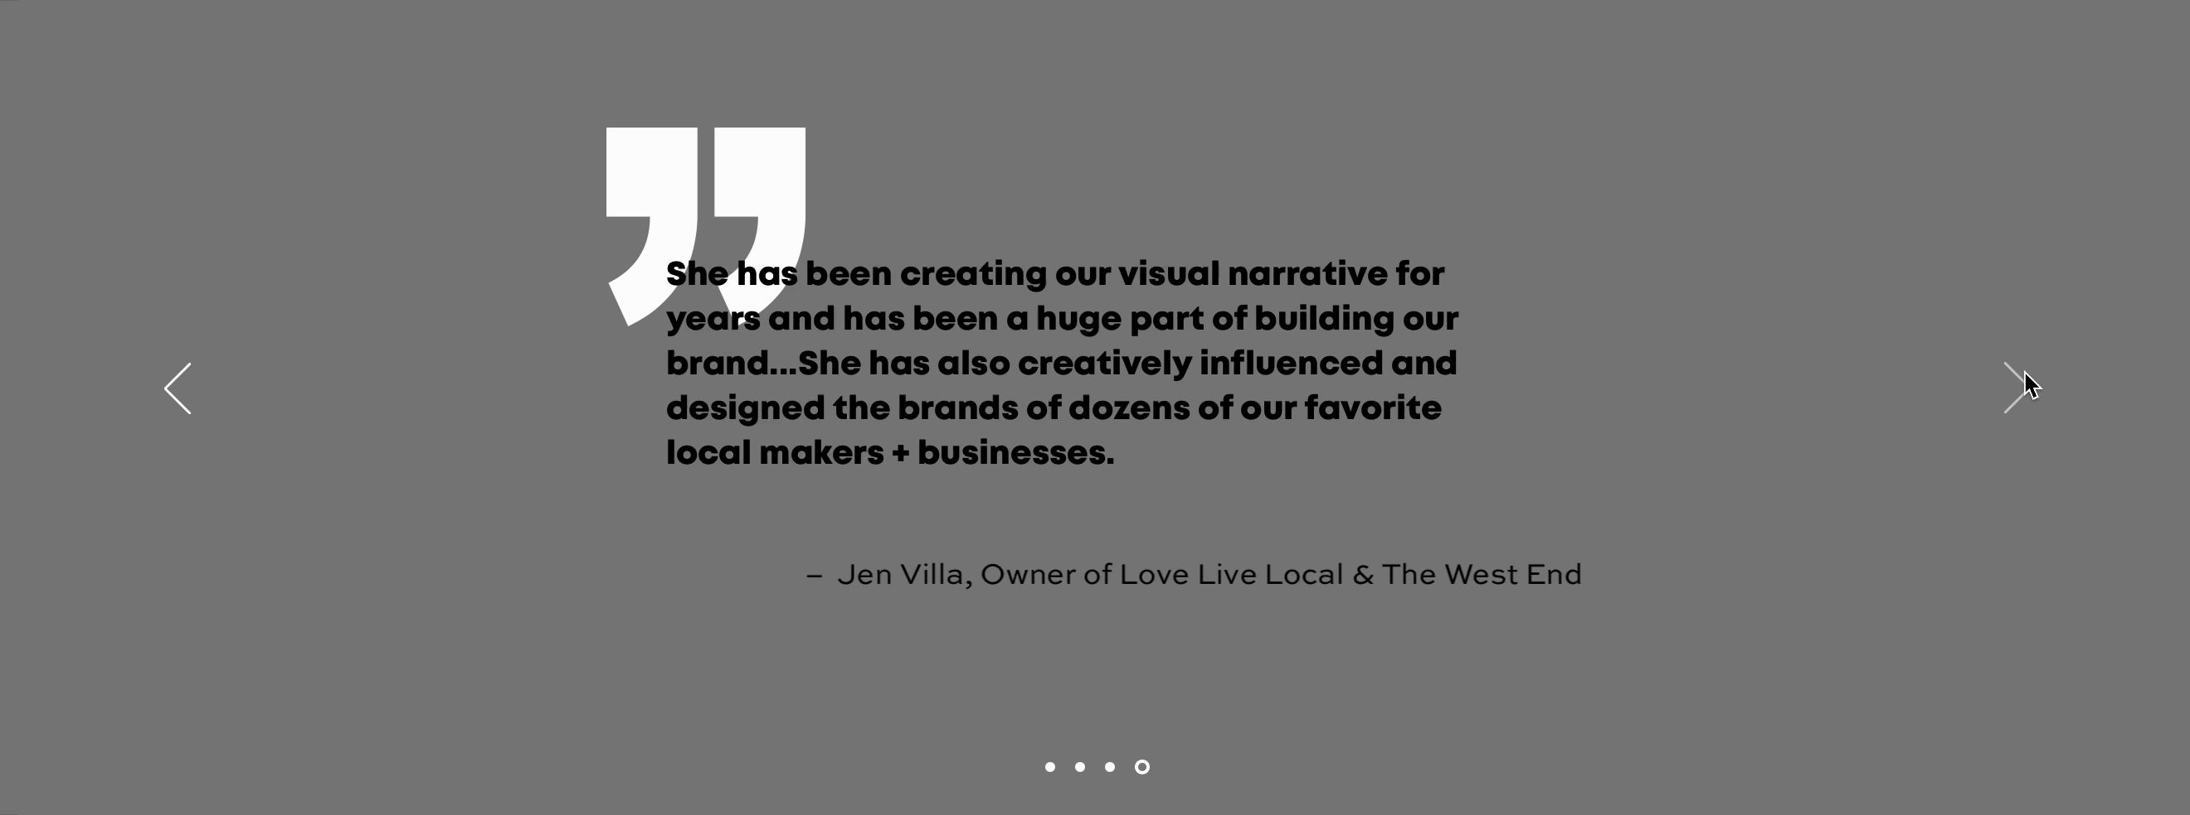
Still Portfolio, but change the whole style and add more animation

Slide 4
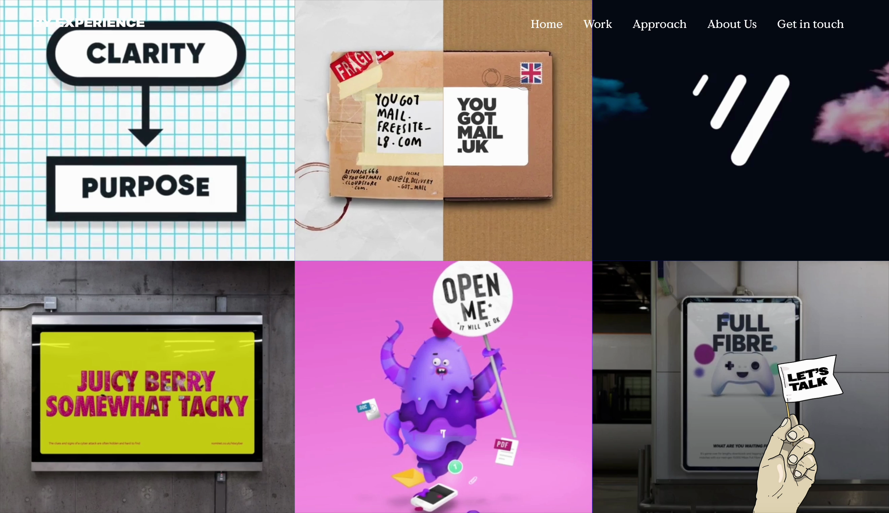


Slide 5
Nav Bar
Carousels
2D
Work

Slide 6
Nav Bar
Carousels
Videos

Slide 7
- Carousels
- Nav Bar
- Animation
- Collapse (About me)
- Scrollspy

Slide 8
THANK YOU

